Slide 1




Notes:
*

Slide 2


UI ENGINEERING STUDIO
UI Engineering Studio. Day 8 Bootcamp: JS ECMA 2015

Slide 3


UI ENGINEERING STUDIO
Const, Let. Destructuring
Ecma 2015
ECMAScript 2015 is the sixth edition of the ECMAScript Language Specification standard. It defines the standard for the JavaScript implementation in SpiderMonkey, the engine used in Firefox and other Mozilla applications, Chrome’s V8 and so on . . .
Symbol
Template Literals
Spread - Param handling
Arrow functions

Slide 4
UI ENGINEERING STUDIO
UI Boot Camp: JS Collections Const - Let
let hey = [1, 2, 3, 4, 5];
const name = 'Pipo';
Const :you can only assign once a value in a variable. Only the reference is immutable, the value can change.
Let: The new var but better ;) New ability of the variable to be scoped to the block level.
Pen

Slide 5
UI ENGINEERING STUDIO
UI Boot Camp: JS Collections
Destructuring
let [one, two] = [1, 2];
var a = 1
var b = 3
//Easiest way to swap the values ?
//(a = 3 , b = 1)
The destructuring assignment syntax is a JavaScript expression that makes it possible to unpack values from arrays, or properties from objects, into distinct variables.
Pen

Slide 6
UI ENGINEERING STUDIO
UI Boot Camp: JS Collections
Symbol
New primitive !. Has the capability to be UNIQUE.
const name = Symbol('Pipo');
Pen

Slide 7
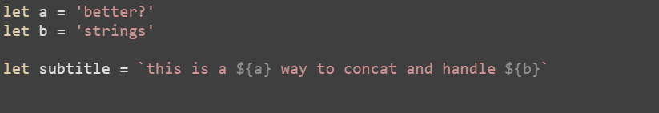
UI ENGINEERING STUDIO
UI Boot Camp: JS Collections
Template literals
Template literals are string literals allowing embedded expressions. You can use multi-line strings and string interpolation features with them.
Pen

Slide 8
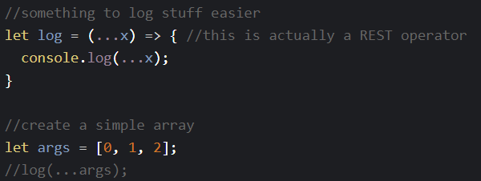
UI ENGINEERING STUDIO
UI Boot Camp: JS Collections Spread and Rest
Spread syntax : allows an iterable such as an array expression or string to be expanded
rest parameter : syntax allows us to represent an indefinite number of arguments as an array.
Spread
Rest

Slide 9
UI ENGINEERING STUDIO
UI Boot Camp: JS Collections
Arrow Functions
Arrow function expression has a shorter syntax than a function expression and does not have its own this, arguments or super. These function expressions are best suited for non-method functions, and they cannot be used as constructors.
Pen

Slide 10
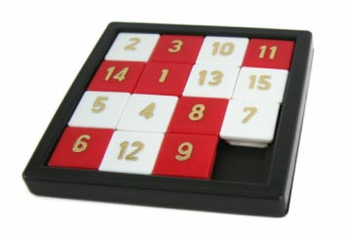
UI ENGINEERING STUDIO
UI Boot Camp: HTML Homework: Sliding Puzzle
A combination puzzle that challenges a player to slide pieces along certain routes to establish a certain end-configuration. The pieces to be moved may consist of simple shapes, or they may be imprinted with colors, patterns, sections of a larger picture (like a jigsaw puzzle), numbers, or letters.
Wikipedia
Develop a Sliding Puzzle using HTML,CSS and JS. Please avoid the use of any library or framework.

Slide 11
Notes:
*

